Slide 1

CoolTShirts Sales Strategy
Learn SQL from Scratch
Diane Corday
May 9, 2019

Slide 2
Table of Contents
Get familiar with CoolTShirts
What is the user journey?
Optimize the campaign budget

Slide 3
1. Getting familiar with CoolTShirts

Slide 4
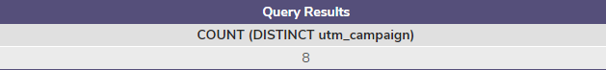
1.1 How many campaigns does CoolTShirts use?
CoolTShirts is an innovative online apparel shop that sells all kinds of
t-shirts, as long as they are T-shaped and cool.
The company is currently running 8 marketing campaigns.
The utm_campaign is the UTM parameter that captures how the user found the site via a specific ad or email blast such as a retargetting-ad or weekly-newsletter.
SELECT COUNT (DISTINCT utm_campaign)
FROM page_visits;

Slide 5

1.2 How many sources does CoolTShirts use?
The company is currently using 6 sources.
The utm_source is the UTM parameter that captures how the user found the site via a specific touchpoint that sent the traffic to them such as google or email.
These touchpoints are also known as channels.
SELECT COUNT (DISTINCT utm_source)
FROM page_visits;

Slide 6
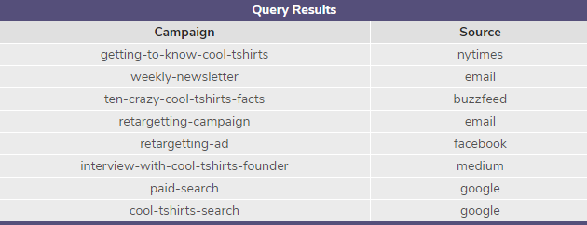
1.3 How are campaigns and sources related?
The results of our query show the campaigns and their related sources.
If an ad campaign drives a lot of visits to the site, then we know the source is working!
SELECT DISTINCT utm_campaign AS 'Campaign',
utm_source AS 'Source'
FROM page_visits;

Slide 7
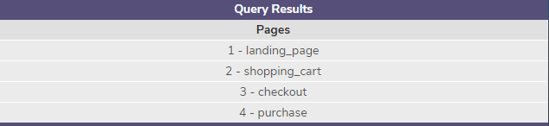
1.4 What pages are on their website?
CoolTShirts has 4 pages on their website.
The page_name is the title of the section of the page that was visited. The column ‘page_name’ has been renamed ‘Pages’ in our query.
SELECT DISTINCT page_name AS 'Pages'
FROM page_visits;

Slide 8
2. What is the user journey?

Slide 9
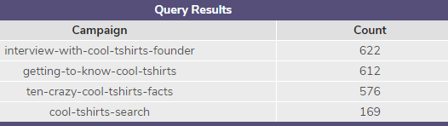
2.1 How many first touches is each campaign responsible for?
CoolTShirts is interested in first-touch attribution which considers the first source for each customer.
This is a good way of knowing how visitors initially discover a website.
Campaigns ‘interview-with-cool-tshirts-founder’, ‘getting-to-know-cool-tshirts’ and ‘ten-crazy-cool-tshirts-facts’ generated 1,810 first touches!
WITH first_touch AS (
SELECT user_id,
MIN(timestamp) as first_touch_at
FROM page_visits
GROUP BY user_id),
ft_attr AS (
SELECT ft.user_id,
ft.first_touch_at,
pv.utm_source,
pv.utm_campaign
FROM first_touch ft
JOIN page_visits pv
ON ft.user_id = pv.user_id
AND ft.first_touch_at = pv.timestamp)
SELECT ft_attr.utm_campaign AS 'Campaign',
COUNT(*) AS 'Count'
FROM ft_attr
GROUP BY 1
ORDER BY 2 DESC;

Slide 10
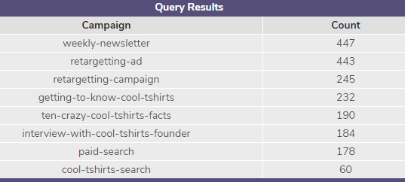
2.2 How many last touches is each campaign responsible for?
CoolTShirts is interested in last-touch attribution which only considers the last source for each customer.
This is a good way of knowing how visitors are drawn back to a website, especially for making a final purchase.
The campaigns ‘weekly-newsletter’ and ‘retargetting-ad’ are responsible for 890 last-touches!
WITH last_touch AS (
SELECT user_id,
MAX(timestamp) as last_touch_at
FROM page_visits
GROUP BY user_id),
lt_attr AS (
SELECT lt.user_id,
lt.last_touch_at,
pv.utm_source,
pv.utm_campaign
FROM last_touch lt
JOIN page_visits pv
ON lt.user_id = pv.user_id
AND lt.last_touch_at = pv.timestamp)
SELECT lt_attr.utm_campaign AS 'Campaign',
COUNT(*) AS 'Count'
FROM lt_attr
GROUP BY 1
ORDER BY 2 DESC;

Slide 11

2.3 How many visitors make a purchase?
When we ran a query to find out how many visitors make a purchase, our results show 361 users completed a purchase.
SELECT COUNT (DISTINCT user_id)
FROM page_visits
WHERE page_name = '4 - purchase';

Slide 12
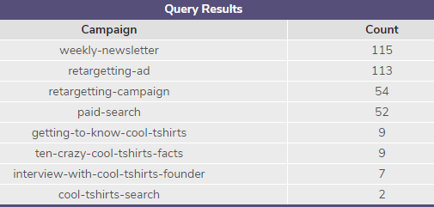
2.4 How many last touches on the purchase page is each campaign responsible for?
Our query breaks down the number of last touches on the purchase page that each campaign is responsible for.
Campaigns ‘weekly-newsletter’ and ‘retargetting ad’ have 228 last touches on the purchase page.
WITH last_touch AS (
SELECT user_id,
MAX(timestamp) as last_touch_at
FROM page_visits
WHERE page_name = '4 - purchase'
GROUP BY user_id),
lt_attr AS (
SELECT lt.user_id,
lt.last_touch_at,
pv.utm_source,
pv.utm_campaign
FROM last_touch lt
JOIN page_visits pv
ON lt.user_id = pv.user_id
AND lt.last_touch_at = pv.timestamp)
SELECT lt_attr.utm_campaign AS 'Campaign',
COUNT(*) AS 'Count'
FROM lt_attr
GROUP BY 1
ORDER BY 2 DESC;

Slide 13
2.5 What is the typical user journey?
Users seem to be responding with interest initially to the publicity generated by the campaigns ‘interview-with-cool-tshirts-founder’, ‘getting-to-know-cool-tshirts’ and ‘ten-crazy-cool-tshirts-facts’ from the sources ‘medium’, ‘nytimes’ and ‘buzzfeed’
respectively.
They seem to return to the website via the campaigns ‘weekly-newsletter’, ‘retargetting-campaign’, ‘retargetting-ad’ and ‘paid-search’ from the sources ‘email’, ‘facebook’, and ‘google’ respectively.

Slide 14
3. Optimize the campaign budget

Slide 15
3.1 CoolTShirts can re-invest in 5 campaigns. Which ones should they pick?
Based on the results of the queries, CoolTShirts should re-invest in the following top 5 marketing campaigns:
Campaign | Source
weekly-newsletter retargetting campaign | email
retargetting-ad | facebook
paid content | google
interview-with-cool-tshirts-founder | medium
getting-to-know-cool-tshirts | nytimes

Slide 16
3.2 Why should they re-invest in these 5 campaigns?
We need to analyze both the first-touch attribution and the last-touch attribution. The results can be crucial to improving CoolTShirts marketing and online presence.
CoolTShirts will optimize their campaign budget by re-investing in campaigns that entice users to land on their site for the first time through medium(print, television or radio) and through interviews in nytimes. This type of publicity has shown in our data that their brand is getting noticed.
At the same time, their campaign budget should also target user emails with weekly newsletters and retargetting campaigns, user facebook accounts with retargetting ads, and paid content on google. The data shows that users are returning to their website through these sources and making purchases.

Slide 17
Thank you!

